Slide 1
Smart Time Table Generator
Team Details:
Anireddy Saikiran Reddy(21EG505802)
S.Venkatesh(21EG505863)
P.Nikhil(21EG505856)
Project Supervisor
Name: Mrs. A.Durga Bhavani
Designation: Assistant Professor

Slide 2
Introduction
Timetabling is one of the common scheduling problems, which can be described as the allocation of resources for tasks under predefined constraints so that it maximizes the possibility of allocation or minimizes the violation of constraints. Due to the non-proportionality between a rapid increase in the number of students enrolled, university courses and accessible resources, the complexity of the problem has become multifold.

Slide 3
Problem Statement
Timetabling is the complex task of assigning resources to tasks under constraints, commonly seen in universities with mismatched student numbers, courses, and resources. The challenge involves optimizing schedules to maximize resource use while minimizing constraint violations. This problem's intricacy arises from the non-proportional growth of students and resources. Solutions require algorithms and heuristics to balance student needs, resource availability, and institutional objectives effectively.

Slide 4
Proposed Method
Data Management: Utilize Django's powerful database management capabilities to store and manage course, instructor, room, and constraint data efficiently.
Scalability: Design the system to handle increasing complexity as the institution grows, ensuring it can accommodate a larger number of courses, students, and resources.
User Preferences: Implement user interfaces to gather student preferences, instructor availability, and other scheduling constraints to improve satisfaction and adherence to requirements.
Constraint Validation: Develop modules within Django that validate and enforce constraints such as avoiding class conflicts, meeting room capacities, and accommodating instructor availability.
Visualization: Create interactive timetable visualization using Django's frontend capabilities to provide a user-friendly overview of schedules, aiding stakeholders in understanding and reviewing generated timetables.

Slide 5
Experiment Environment
Operating system: Windows
IDE : VS Code, pycharm
Libraries : Django, OpenPyXL or xlrd
Django:Django simplifies the development of web-based tools that generate schedules based on input data, such as Excel files. Its powerful features and ease of integration enable efficient creation, customization, and deployment of timetable applications for educational institutions or businesses.
OpenPyXL or xlrd: These libraries are useful for reading data from Excel files. OpenPyXL supports .xlsx files, while xlrd is used for .xls files.
Programming Languages: Python 3.10

Slide 6
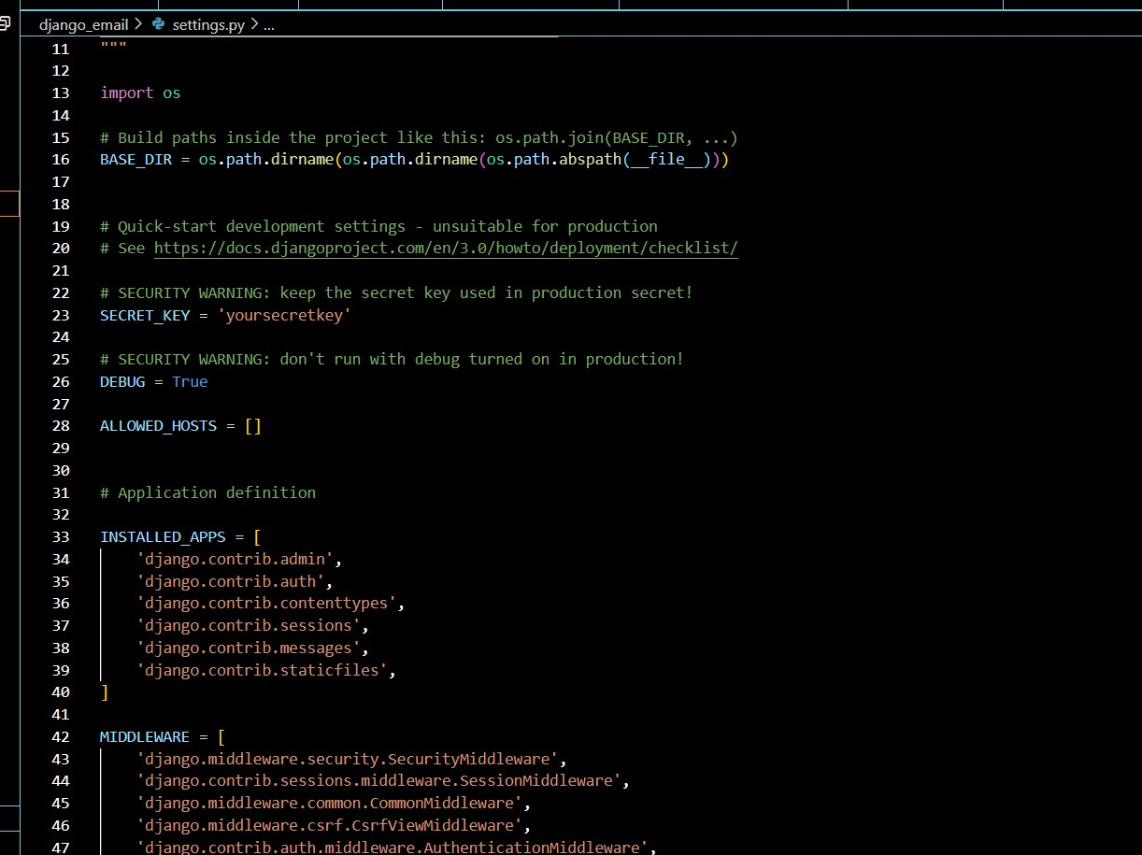
Experiment Screen shorts

Slide 7
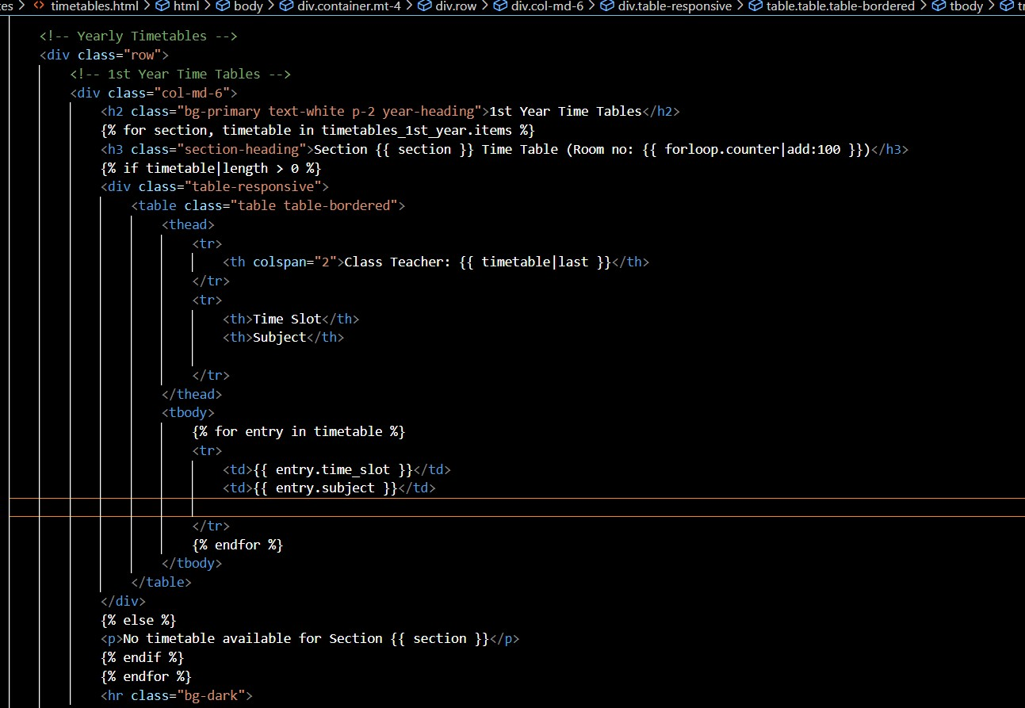
Experiment Screen shorts

Slide 8
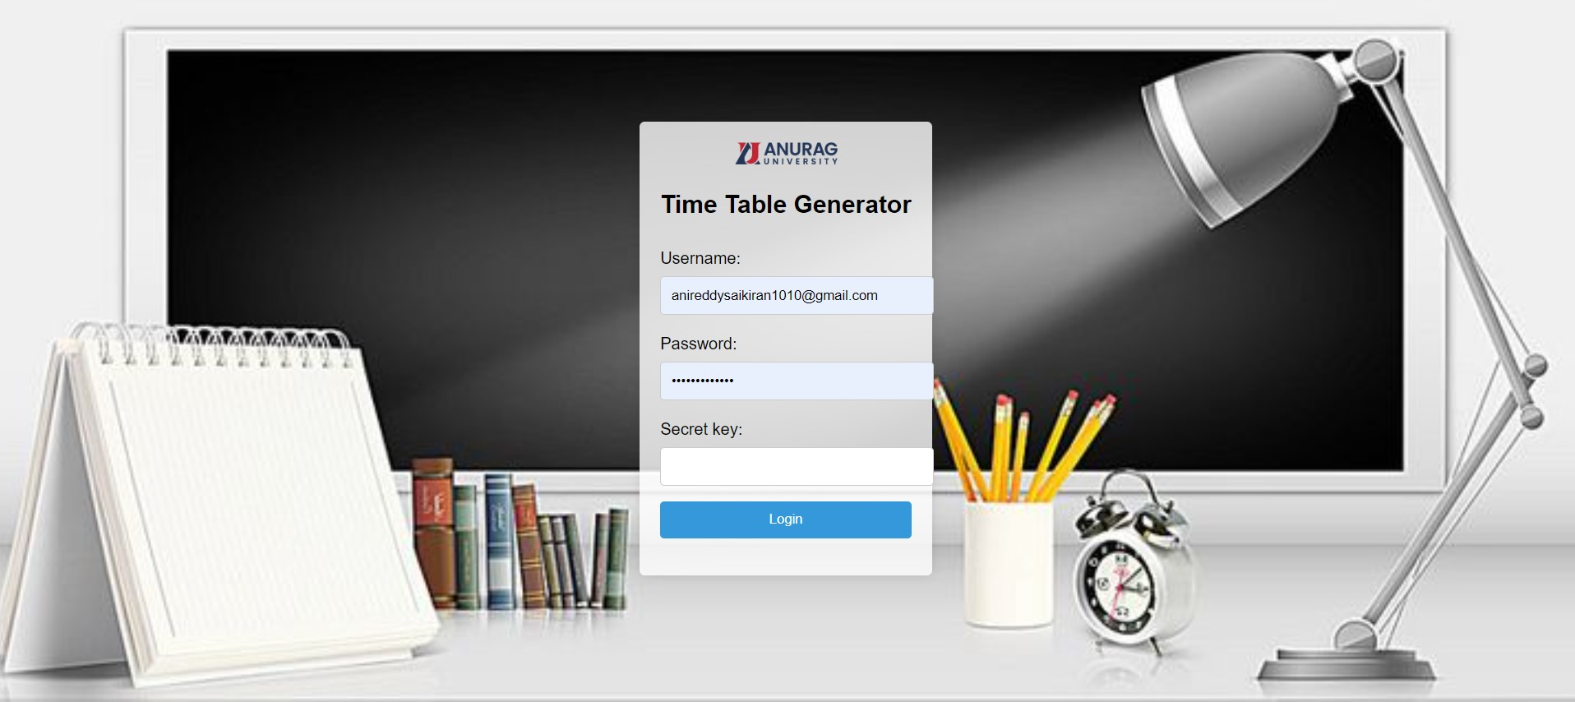

Experiment Results

Slide 9
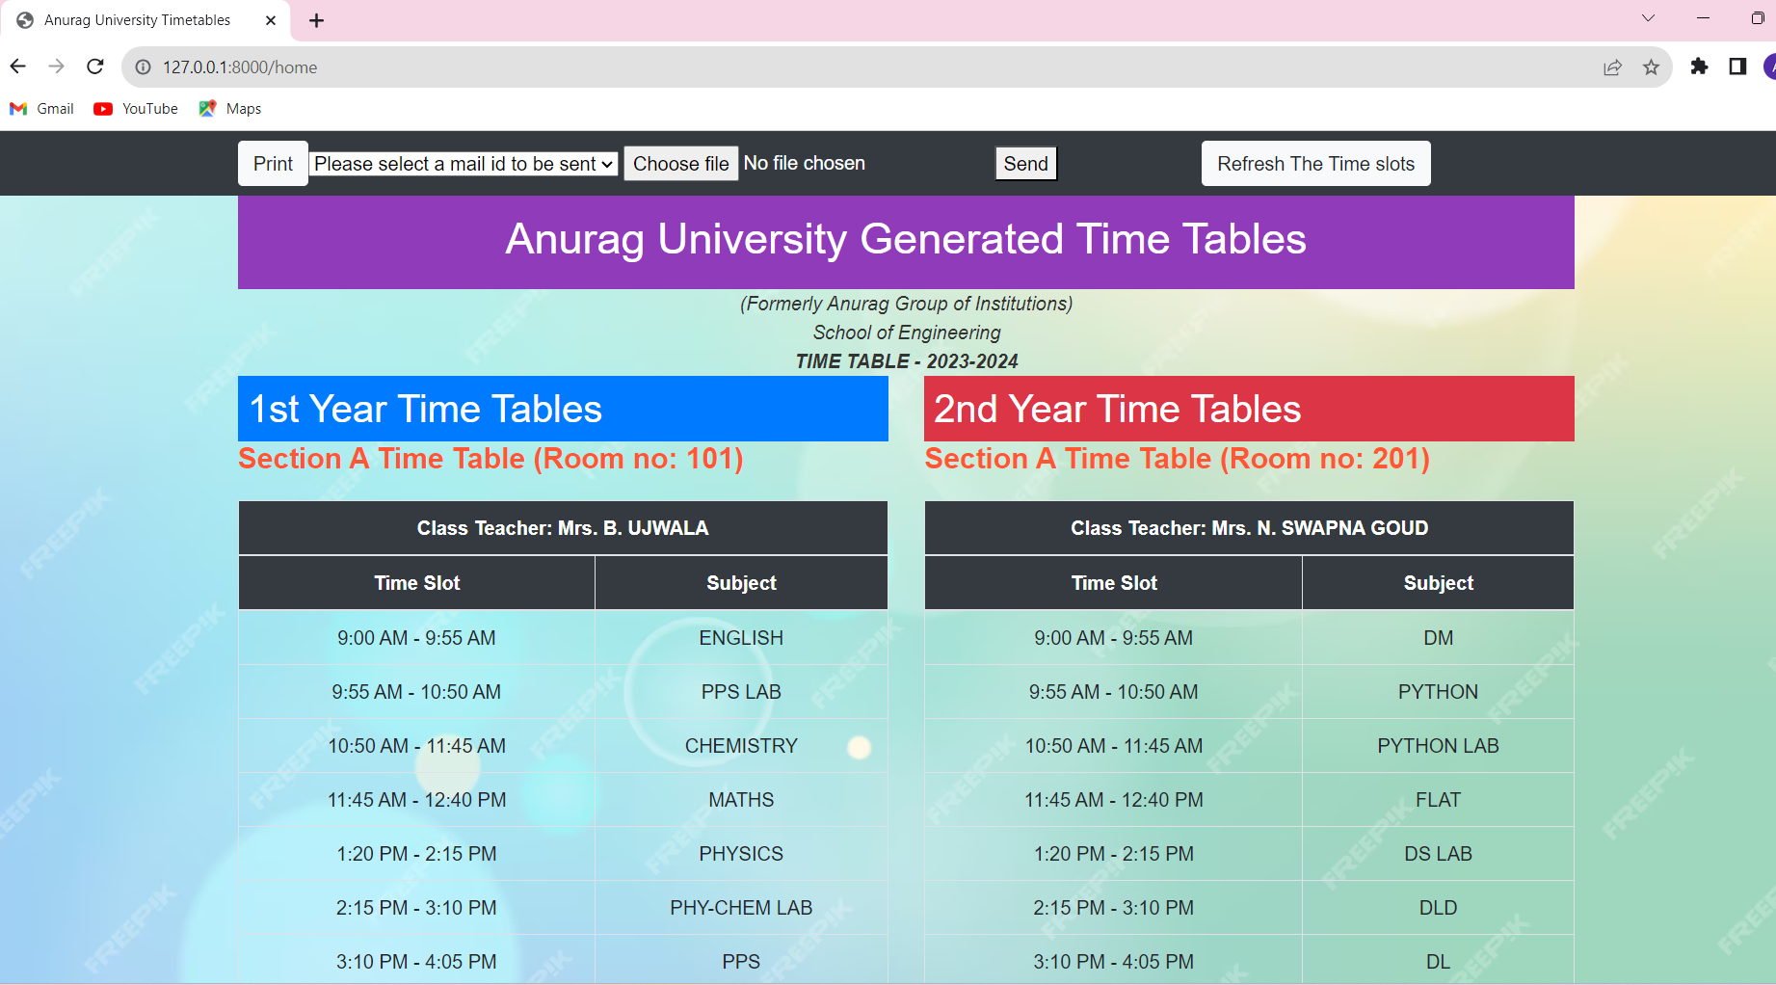
Experiment Results

Slide 10
Finding
By giving input data as excel format it is generating time table for every year of different sections by using django frame work with python.

Slide 11
Justification
1.What are parameters improved by your method?
Data Management
Visualization
2. why your parameter values improved?
Time
Security

